Slide 1
Importing CSV
Make sure all currency values are in Pounds to two decimal places. Using a suitable database package, import the file Games.CSV Use appropriate data types Set the Gamecode as the key field.
Import the file Onlineshop.CSV as a new table in your database. Use appropriate data types Set the Shopcode as the key field.
Import the file Publisher.CSV as a new table in your database. Use appropriate data types Set the Publishercode as the key field.
Create the appropriate one to many relationships using the key fields: Identify the primary and foreign keys which will be used.

Slide 2
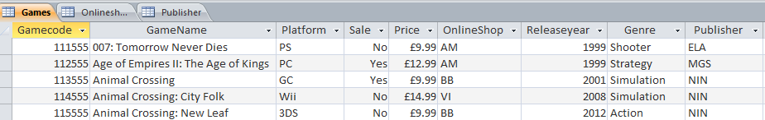
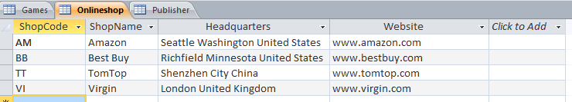
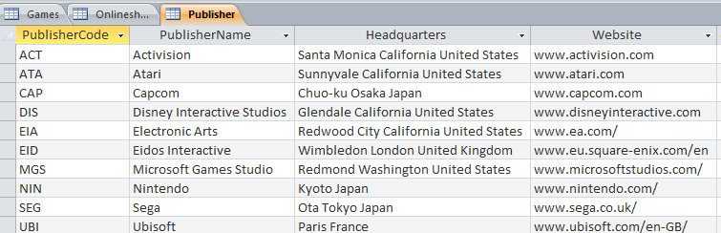

Slide 3
Query and Report
Create a report for the phones which are part of sale promotion. Contains a new field called New_Price which is calculated at run-time. 15% needs to subtracted from the price. Shows only the records where: Platform are X360 or PS3 or N64 Not Shooting or Racing or Action Genre Publisher is Electronic Arts Sale Price is between £9.00 and £15.00 Games which are in Sale Shows only the fields GameName, PublisherName Platform, Price, ShopName and New_Price Fits on a single page wide and has page orientation of landscape Sorts the data into ascending order of GameName Calculates the total value of games using the new prices with an appropriate label and place it at the bottom of the report. Includes the heading New Game Prices at the top of the page Has your name on the right in the page footer.

Slide 4
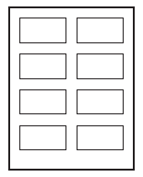
Label
You are going to prepare labels for some games which are on sale. Produce labels from all the data which: Arrange labels in two columns. Only include games which are in sale, Action or Sport Genre, sold at Amazon and are either a Fifa or Tony Hawk Game. Show only the fields GameName, Shop Name, Price, PublisherCode and Platform each on a separate line. Display the field name as well as the data In a larger font, at the top of each label, include the heading: End of Season Sale Include your name at the bottom of each label.

Slide 5
Summery Queries
Brand & Sum of Price Show only the Platform and Price Calculates the total value of games for each Platform Counts the number of games for each Platform.
Extract the summery Query into a Word Document.
Create a bar chart showing the number of games for each platform. Include suitable titles for the bar chart and the axis. Do not show the legend.
Extension: Make a query showing all the games which are on sales at Amazon. Using these records create a summery query: Show only the Genre and Price Calculates the total value of games for each Genre Counts the number of games for each Genre. Create a bar chart showing the number of games for each genre. Include suitable titles for the bar chart and the axis.

